Slide 1
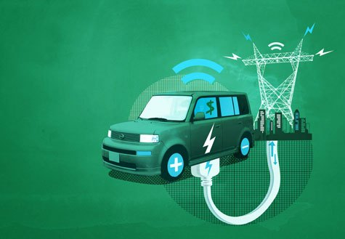
Sensing Current in Electric Vehicle Supply Equipment
Prof. Olga Mironenko
Department of Electrical and Computer Engineering
Spring 2024
https://transparencyjournal.com/vehicle-grid-v2g-technology-improves-battery-life-evs-study/

Slide 2
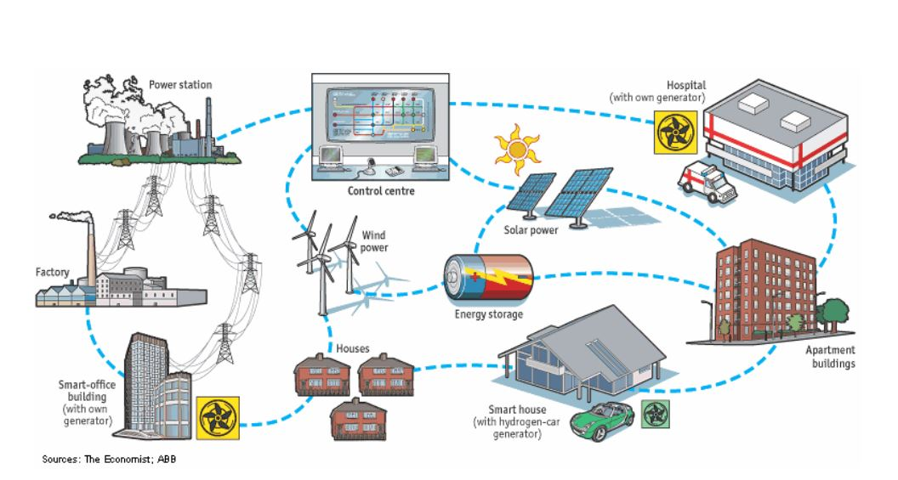
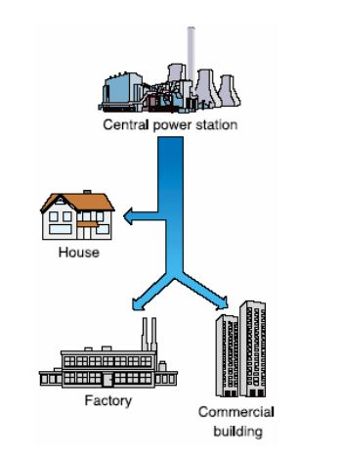
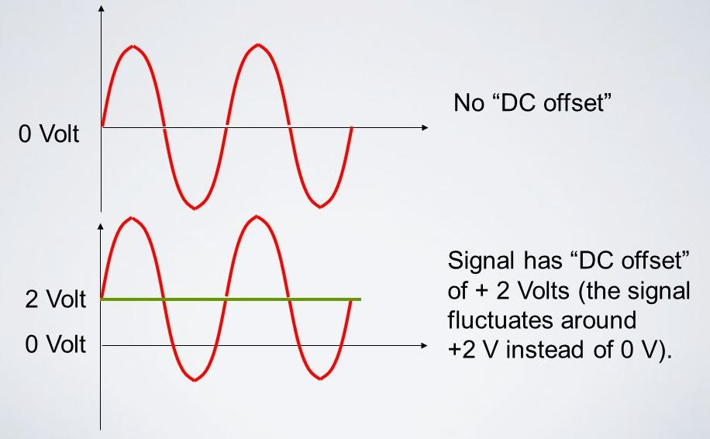
Distributed power system
DC injection danger for the grid!!
“Limitation of DC injection”,
IEEE 1547-2018: Standard for Interconnection and Interoperability of Distributed Energy Resources with Associated Electric Power Systems Interfaces
Traditional centralized power system
Gertman, Lars, Per Karlsson, and Olof Samuelsson. "On DC Injection to AC Grids from Distributed Generation." LTH/IEA, Lund University, Lund, Sweden, 2005.
Notes:
fix

Slide 3
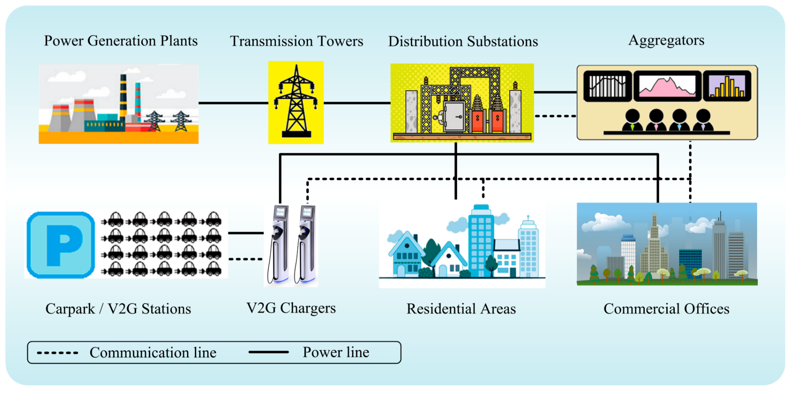
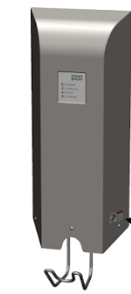
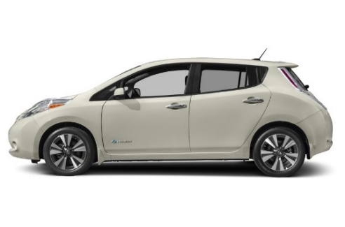
Electric Vehicle (EV) as a Distributed Energy Resource or Vehicle-to-Grid (V2G)
Operator
Operator
Electric Vehicle Supply Equipment (EVSE)
EVSEs must verify
the DC injection level
http://www.mdpi.com/1996-1073/10/11/1880/htm
Notes:
fix

Slide 4
 | Single-phase EVSE (19.2 kW) | Three-phase EVSE (100 kW)
$$I_{rated}$$ | 80 A | 120 A
Voltage | 240V (US), 230V(Europe) | 230V/400V (Europe), 277V/480V (US), 347V/600V (Canada)
AC current metering accuracy class | 0.5, 1.0, 2.0
High accuracy AC current measurements
A single device = cost reduction
DC injection detection
1
Today’s Current Sensor capabilities:
(BCT-013-200 Current transformer)
For utility: High accuracy AC current metering
up to 200A AC
Accuracy is 0.1%
For grid protection: unable to detect DC current
1. The accuracy criteria for revenue metering are described in NIST HB-44, ANSIC12.20 and IEC 62053-11 standards
Notes:
fix

Slide 5
Selecting the new current sensor based on following requirements:
For utility: High accuracy AC current metering
0.5% or less
Current rating: ≥ 120A AC
For grid protection: DC detection capability:
DC injection limit is 0.5% of $I_{rated}$ (400mA or 600 mA)
Mass production of EVSE requires a cost-effective solution
low cost
The DC injection limit is defined according to “Limitation of DC injection” section of IEEE 1547-2018 standard.
Notes:
fix

Slide 6
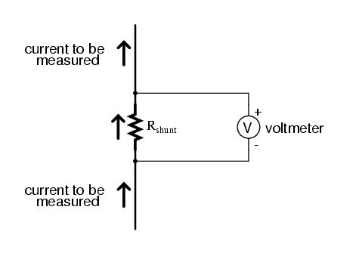
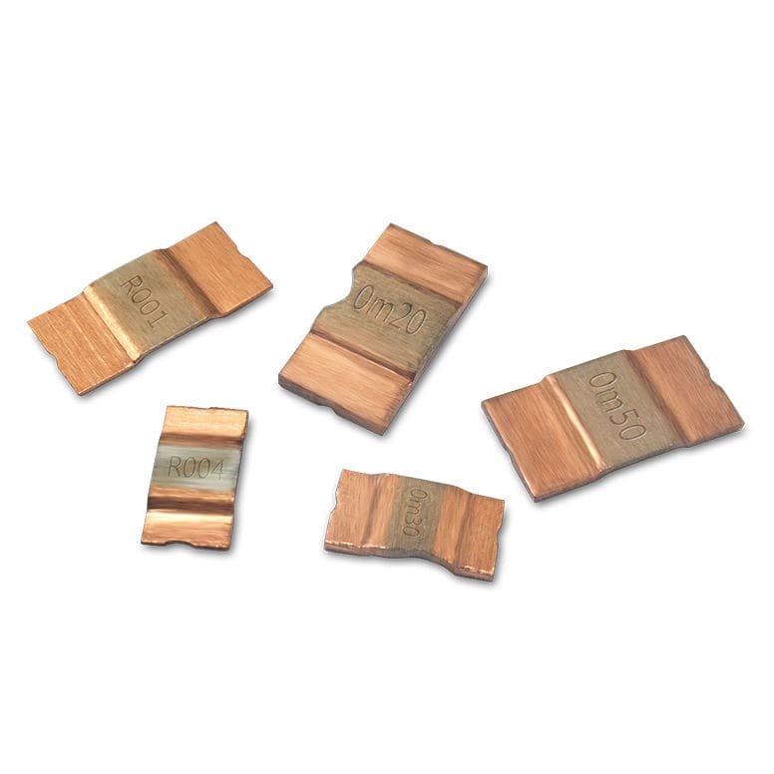
Current sensing techniques overview
1. Shunt
Pros | Simplicity ☑ Low cost ☑ AC+DC current ☑ AC ≥ 120A? YES ☑
Cons | Losses Heat No galvanic isolation
Accuracy | 0.1%, 0.25%, 0.5% ☑
Shunt resistor operating principle.
https://www.allaboutcircuits.com/textbook/direct-current/chpt-8/ammeter-design/

Slide 7
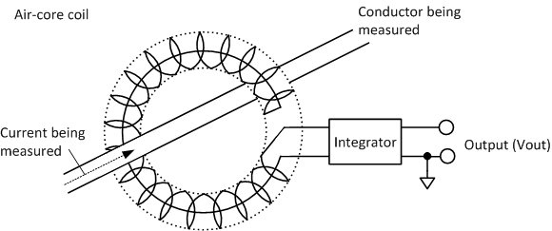
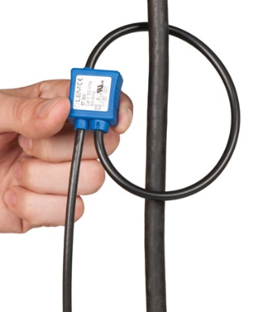
Pros | Simplicity Flexibility Cost-effectiveness Galvanic isolation Linearity AC ≥ 120A? YES ☑
Cons | AC current only ☒ Integrator is required at the output
Accuracy | 1% ☒
Current sensing techniques overview
2. Rogowski coil.
Rogowski coil operating principle.
https://www.hioki.com/en/products/listUse/?category=17

Slide 8
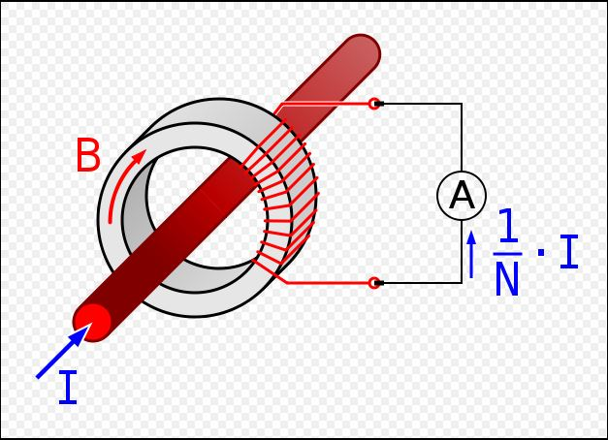
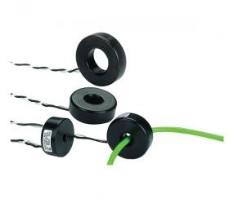
Current sensing techniques overview
3. Current transformer (CT).
 | CT
Pros | - Simplicity Low losses No amplification is required at the output Galvanic isolation AC ≥ 120A? YES ☑
Cons | - AC current only ☒
Accuracy | - 0.1% ☑
CT operating principle.
https://en.wikipedia.org/wiki/Current_transformer

Slide 9
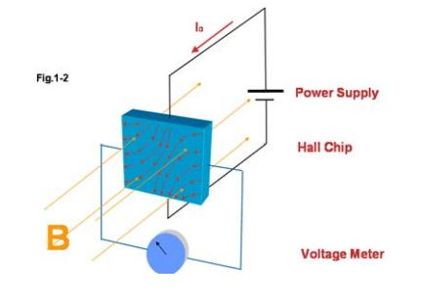
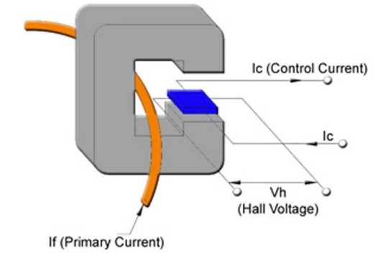
Current sensing techniques overview
4. Hall-Effect Sensors.
Thin conductive material
Hall-Effect
Hall-effect current sensor structure
https://sensing.honeywell.com/index.php?ci_id=51431

Slide 10
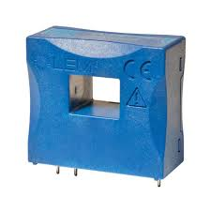
Current sensing techniques overview
4. Hall-Effect Sensors.
Pros | AC+DC current ☑ Low losses Galvanic isolation AC ≥ 120A? YES ☑
Cons | High cost ☒ Lack of accuracy at low currents (for sensors with $I_{prim}$ > 100A) ☒
Accuracy | - 0.05% - 2% ☑
LEM Hall-Effect sensor LA 150-P, LEM datasheet

Slide 11
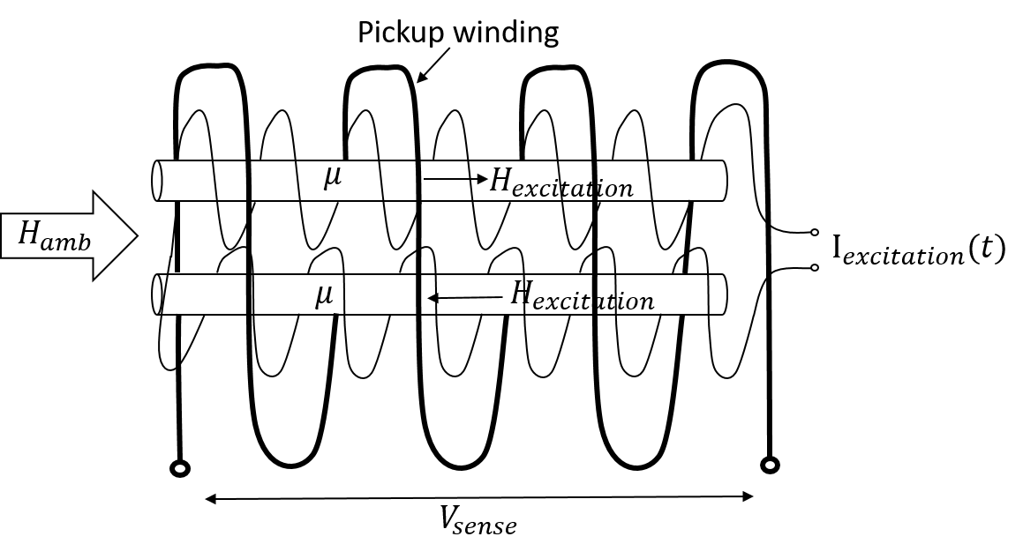
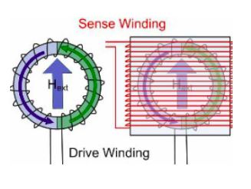
Current sensing techniques overview
5. Fluxgate Sensors: working principle.
Basic fluxgate sensor
Twin - rod fluxgate
(Vacquier fluxgate)
Ring core fluxgate
http://www.imperial.ac.uk/space-and-atmospheric-physics/research/areas/space-magnetometer-laboratory/space-instrumentation-research/magnetometers/fluxgate-magnetometers/how-a-fluxgate-works/ ;

Slide 12
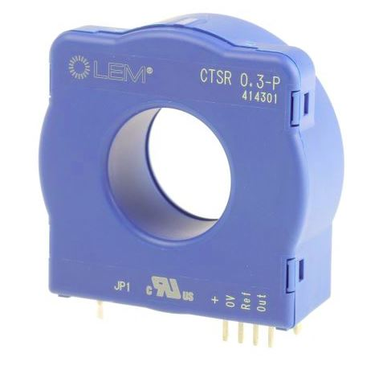
Current sensing techniques overview
5. Fluxgate Sensors: pros and cons.
Pros | AC+DC current ☑ Low losses Galvanic isolation AC ≥ 120A? YES ☑
Cons | High cost ☒ High complexity ☒
Accuracy | - up to 0.0002% ☑
LEM fluxgate sensor CTSR 0.3-P, LEM datasheet

Slide 13
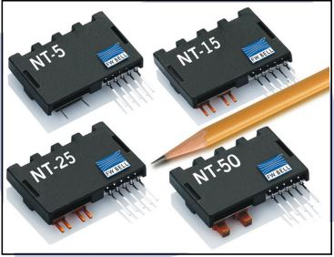
Current sensing techniques overview
6. Magneto Resistance Effect sensors.
Resistance varies as a function of applied magnetic field.
Pros | AC+DC current AC ≥ 120A? YES ☑
Cons | High cost ☒ Mounting ☒
Accuracy | - 0.8% ☒
Anisotropic Magneto Resistance (AMR) Sensors
No external magnetic field
I
Ferromagnetic strip
$$R_{max}$$
Applied external magnetic field
I
Ferromagnetic strip
$${R<R}_{max}$$
F.W. Bell AMR current sensors
Magneto-resistive current sensors for peak currents up to 150a. Tech. Rep.; F.W. Bell

Slide 14
Current sensing techniques overview
6. Magneto Resistance Effect sensors.
Pros | AC+DC current ☑ Low cost ☑
Cons | Mounting ☒ Low current applications ☒
Accuracy | - 2% ☒
Giant Magneto Resistance (GMR) Sensors
No external magnetic field
Ferromagnetic
I
Ferromagnetic
High resistance
Thin conductor
Applied external magnetic field
I
Ferromagnetic
Ferromagnetic
Low resistance
Acs70331: High sensitivity, 1 MHz, GMR-based current sensor IC in space-saving low resistance QFN and SOIC packages. Tech. Rep.; Allegro microsystems; 2019

Slide 15
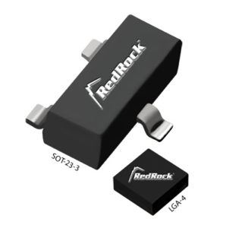
Current sensing techniques overview
Pros | AC+DC current ☑ AC ≥ 120A? YES ☑ Low cost ☑
Cons | Mounting ☒ Complexity ☒
Accuracy | - 0.5% ☑
6. Magneto Resistance Effect sensors.
Tunneling Magneto Resistance (TMR) Sensors
Resistance
Insulator
Free layer
Free layer
Pinned layer
Pinned layer
Low current
High current
External
magnetic field
CotoTechnology, REDROCK 111 TMR magnetic sensor

Slide 16
Which current sensor is the most suitable for EVSE application?
 | AC+DC | AC ≥ 120A | 0.5% accuracy at $I_{low}$ | Affordable price | Simplicity and convenient mounting
Shunt | ✓ | ✓ | ✓ | ✓ | ✓
Rogowski coil | ×
CT | ×
Hall-Effect | ✓ | ✓ | ×
Fluxgate | ✓ | ✓ | ✓ | ×
AMR | ✓ | ✓ | ×
GMR | ✓ | × | ×
TMR | ✓ | ✓ | ✓ | ✓ | ×

